Slide 1

C# Databases Advanced with Entity Framework Core
Course Introduction
SoftUni Team
Technical Trainers
Software University
https://softuni.bg/

Slide 2
Table of Contents
Course Objectives
Training and Team
Course Organization
Course Infrastructure
Evaluation Criteria

Slide 3
Have a Question?
sli.do
#CSharpDB

Slide 4

Course Objectives

Slide 5
Course Objectives
ADO.NET Library
ORM Fundamentals
Code-First and Database-First
Automapper Library and Custom Automapper
Advanced LINQ
JSON and XML
Best Practices and Architecture

Slide 6
Practical Programming Exam
3 practical problems for 6 hours
Model Definition
Data Import
Data Export
Automated judge system
http://judge.softuni.bg
Solutions are evaluated for correctness only
Code quality is still not measured

Slide 7

Exam Demonstration

Slide 8

The Team

Slide 9


Stamo Petkov
Head Of Department at Information Services Plc.
Worked with various technologies
.NET and C#, BASIC, Pascal, Object Pascal, PHP
More than 15 years of experience
Experienced Lecturer
C# Basics and ASP.NET MVC @ Softuni

Slide 10
INFORMATION SERVICES
Key partner of the state institutions in the implementation of ICT projects
The Ministry of Finance
The National Revenue Agency
The Customs Agency
The Ministry of Regional Development and Public Works
The first governmentally approved provider of qualified certification services in Bulgaria
https://www.is-bg.net/bg/

Slide 11
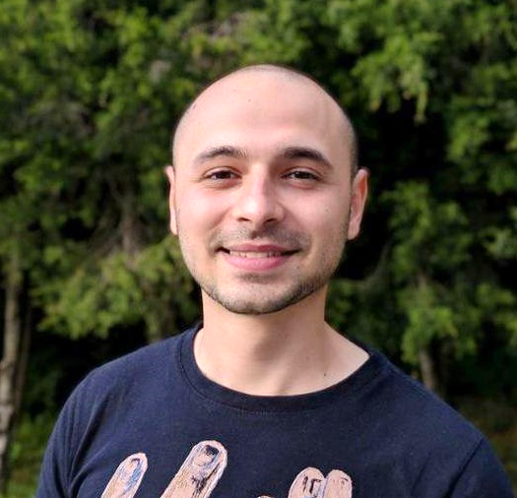
Stoyan Shopov
Technical Trainer @ SoftUni
ASP.NET Web Developer
Experience with MSSQL and ADO.NET
Mountain lover

Slide 12

Course Organization

Slide 13
Course Information
7 weeks / 4 times a week
15 Credits
Time Frame
18-Feb-2019 – 7-Apr-2019
Exam
07-Apr-2019
Retake
18-Apr-2019

Slide 14

Homework Assignments & Exercises
Your homework is mainly work in class
Lesson days → slides + live demos + exercises
Exercise days → only exercises
How to submit your homework?
Submitted in the judge system
Do your homework when it's due
Assignments pile up quickly

Slide 15


Scoring System for the Course
Mandatory:
Final exam – 90%
Exercises & homework – 10%
Bonuses:
Presence in class – 5% bonus
Forum activity – bonus up to 5%

Slide 16



Course Web Site, Forum and FB Group
Official web site:
Official discussion forum:
Official Facebook group:
https://softuni.bg/courses/databases-advanced-entity-framework
https://softuni.bg/forum/categories/63/ csharp-db-fundamentals
https://www.facebook.com/groups/ CSharpDBFUndamentalsJanuary2019/

Slide 17
https://softuni.bg/courses/databases-advanced-entity-framework

Slide 18













SoftUni Diamond Partners

Slide 19




SoftUni Organizational Partners

Slide 20




Trainings @ Software University (SoftUni)
Software University – High-Quality Education and Employment Opportunities
softuni.bg
Software University Foundation
http://softuni.foundation/
Software University @ Facebook
facebook.com/SoftwareUniversity
Software University Forums
forum.softuni.bg

Slide 21

License
This course (slides, examples, demos, videos, homework, etc.) is licensed under the "Creative Commons Attribution-NonCommercial-ShareAlike 4.0 International" license

